Slide 1
Javascript
Ms. Nabeela Bibi

Slide 2
Where To Write
The <script> Tag
In HTML, JavaScript code is inserted between <script> and </script> tags.
You can place any number of scripts in an HTML document. Scripts can be placed in the <body>, or in the <head> section of an HTML page, or in both.
External scripts are practical when the same code is used in many different web pages.
JavaScript files have the file extension .js.
To use an external script, put the name of the script file in the src (source) attribute of a <script> tag:

Slide 3
JavaScript Display Possibilities
JavaScript can "display" data in different ways:
Writing into an HTML element, using innerHTML.
Writing into the HTML output using document.write().
Writing into an alert box, using window.alert().
Writing into the browser console, using console.log().

Slide 4
Using innerHTML
To access an HTML element, JavaScript can use the document.getElementById(id) method.
The id attribute defines the HTML element. The innerHTML property defines the HTML content:

Slide 5
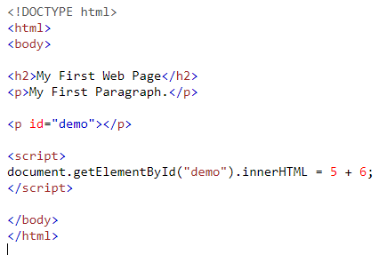
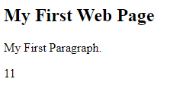

Slide 6
Using document.write()
For testing purposes, it is convenient to use document.write():
Using document.write() after an HTML document is loaded, will delete all existing HTML:

Slide 7
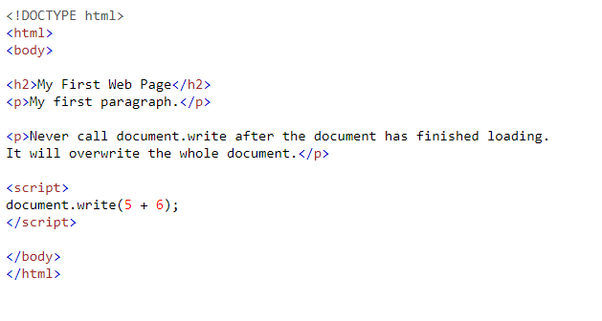
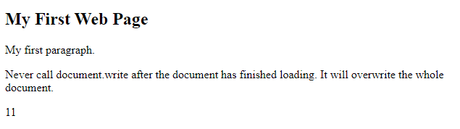

Slide 8
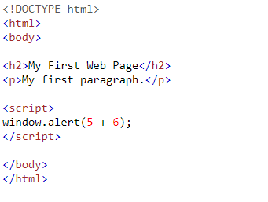
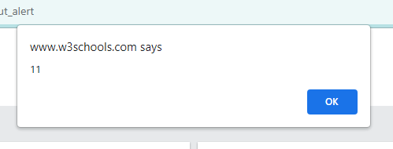
Using window.alert()
You can use an alert box to display data:

Slide 9
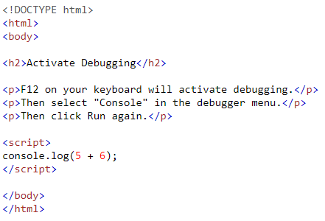
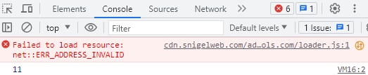
Using console.log()
For debugging purposes, you can call the console.log() method in the browser to display data.

Slide 10
JavaScript Print
JavaScript does not have any print object or print methods.
You cannot access output devices from JavaScript.
The only exception is that you can call the window.print() method in the browser to print the content of the current window.

Slide 11
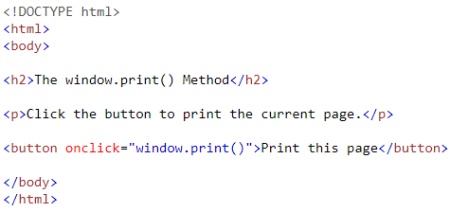
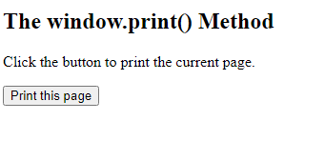

Slide 12
JavaScript Objects
You have already learned that JavaScript variables are containers for data values.
The values are written as name:value pairs (name and value separated by a colon).
It is a common practice to declare objects with the const keyword.
objectName.propertyName or objectName["propertyName"]
Objects can also have methods.
Methods are actions that can be performed on objects.
Methods are stored in properties as function definitions

Slide 13
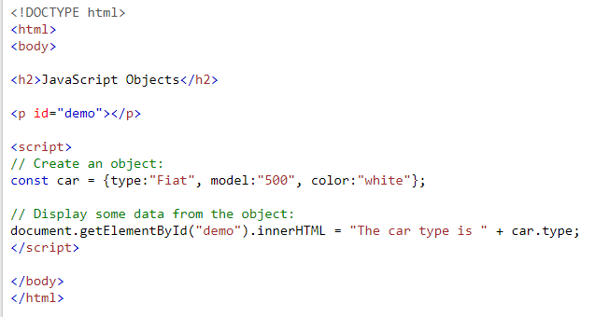
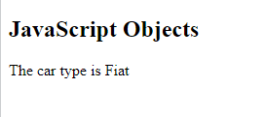

Slide 14
JavaScript Events
HTML events are "things" that happen to HTML elements.
When JavaScript is used in HTML pages, JavaScript can "react" on these events.
An HTML event can be something the browser does, or something a user does.
Here are some examples of HTML events:
An HTML web page has finished loading
An HTML input field was changed
An HTML button was clicked
Often, when events happen, you may want to do something.
JavaScript lets you execute code when events are detected.
HTML allows event handler attributes, with JavaScript code, to be added to HTML elements.

Slide 15
With single quotes:
<element event='some JavaScript'>
With double quotes:
<element event="some JavaScript">

Slide 16
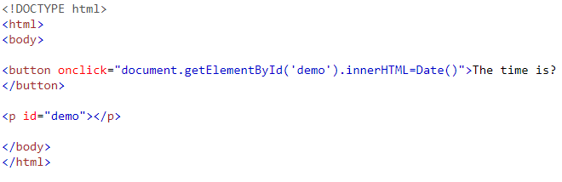



Slide 17
Common HTML Events
Event | Description
onchange | An HTML element has been changed
onclick | The user clicks an HTML element
onmouseover | The user moves the mouse over an HTML element
onmouseout | The user moves the mouse away from an HTML element
onkeydown | The user pushes a keyboard key
onload | The browser has finished loading the page

Slide 18
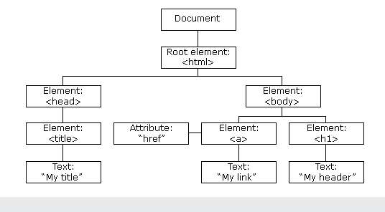
The HTML DOM (Document Object Model)
When a web page is loaded, the browser creates a Document Object Model of the page.
The HTML DOM model is constructed as a tree of Objects:

Slide 19
With the object model, JavaScript gets all the power it needs to create dynamic HTML:
JavaScript can change all the HTML elements in the page
JavaScript can change all the HTML attributes in the page
JavaScript can change all the CSS styles in the page
JavaScript can remove existing HTML elements and attributes
JavaScript can add new HTML elements and attributes
JavaScript can react to all existing HTML events in the page
JavaScript can create new HTML events in the page

Slide 20
HTML DOM
The HTML DOM is a standard object model and programming interface for HTML. It defines:
The HTML elements as objects
The properties of all HTML elements
The methods to access all HTML elements
The events for all HTML elements
The HTML DOM is a standard for how to get, change, add, or delete HTML elements.

Slide 21
The HTML DOM Document Object
The document object represents your web page.
If you want to access any element in an HTML page, you always start with accessing the document object.

Slide 22
Changing HTML Elements
Property | Description
element.innerHTML = new html content | Change the inner HTML of an element
element.attribute = new value | Change the attribute value of an HTML element
element.style.property = new style | Change the style of an HTML element
Method | Description
element.setAttribute(attribute, value) | Change the attribute value of an HTML element

Slide 23
JavaScript Event Handlers
Event handlers can be used to handle and verify user input, user actions, and browser actions:
Things that should be done every time a page loads
Things that should be done when the page is closed
Action that should be performed when a user clicks a button
Content that should be verified when a user inputs data

Slide 24
Many different methods can be used to let JavaScript work with events:
HTML event attributes can execute JavaScript code directly
HTML event attributes can call JavaScript functions
You can assign your own event handler functions to HTML elements
You can prevent events from being sent or being handled

Slide 25
HTML DOM Events
DOM Events allow JavaScript to add event listener or event handlers to HTML elements.
Examples
In HTML onclick is the event listener, myFunction is the event handler:
<button onclick="myFunction()">Click me</button>
In JavaScript click is the event, myFunction is the event handler:
button.addEventListener("click", myFunction);

Slide 26
The addEventListener() method
The addEventListener() method attaches an event handler to the specified element.
The addEventListener() method attaches an event handler to an element without overwriting existing event handlers.
You can add many event handlers to one element.
You can add many event handlers of the same type to one element, i.e two "click" events.
You can add event listeners to any DOM object not only HTML elements. i.e the window object.
The addEventListener() method makes it easier to control how the event reacts to bubbling.
When using the addEventListener() method, the JavaScript is separated from the HTML markup, for better readability and allows you to add event listeners even when you do not control the HTML markup.
You can easily remove an event listener by using the removeEventListener() method

Slide 27
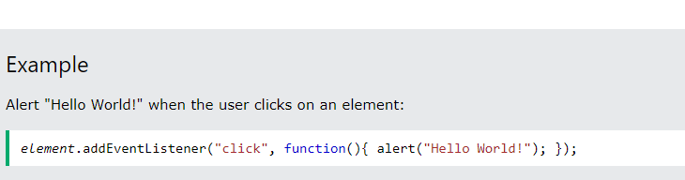
Syntax
element.addEventListener(event, function);
The first parameter is the type of the event (like "click" or "mousedown" or any other HTML DOM Event.)
The second parameter is the function we want to call when the event occurs.

Slide 28
Thank you!

